Slide 1
Financial Analysis of Movie Industry Stocks
Trends, Volatility, and Correlation
B Malsawmtluanga 3rd Semester MCA Brindavan College

Slide 2
Abstract
This case study investigates the stock price trends, volatility, and correlation between key companies in the movie and entertainment industry, such as Disney, Netflix, Comcast, and Sony. Using historical stock data from 2019 to 2023, we explore how these companies have performed over time and how global events have influenced their stock prices.
Through trend analysis, volatility measurement, correlation assessment, and moving average techniques, we provide insights into the financial health and market dynamics of the movie industry. The analysis also serves as a tool for investors to understand the market movements and the interrelationships between these companies, providing guidance on potential investment strategies.

Slide 3
Problem Statements
This case study aims to address the following key questions:
How have stock prices for companies in the movie and entertainment industry evolved over the past few years?
What is the volatility of stocks for major entertainment companies, and how has it changed over time?
How are these companies' stock performances correlated, and what does this mean for potential diversification strategies?
How do moving averages help identify trends and inform investment decisions?

Slide 4
Proposed Solution
Data Collection
Trend Analysis
Volatility Analysis
Correlation Analysis
Moving Average Analysis
Insights and Recommendations

Slide 5

Implementation Code
GitHub: https://github.com/MalsawmtluangaBualte/CaseStudy_TSP4.0/blob/main/movie.py

Slide 6
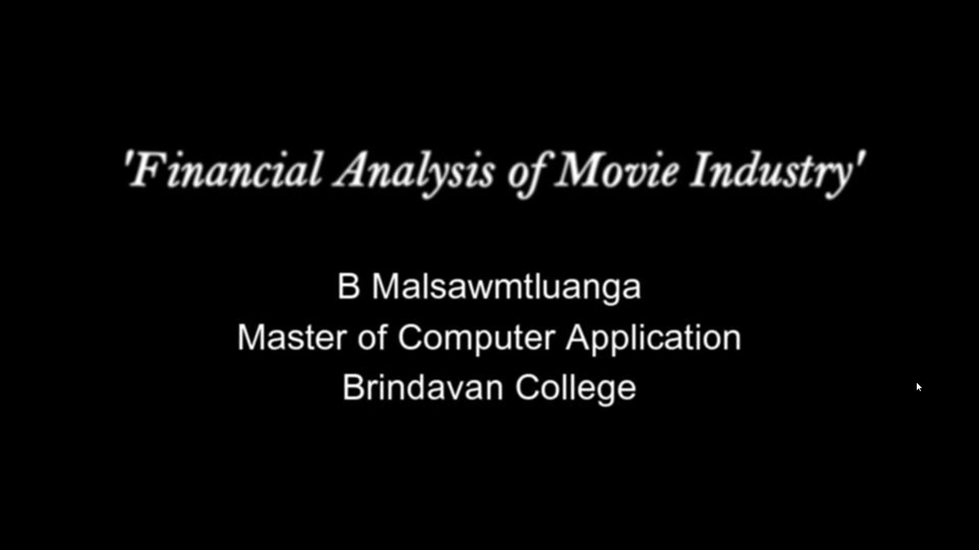
Short Video

Slide 7
Video Link
Google Drive:
https://drive.google.com/file/d/1RJPCNnpY4HDicVAgZvRg_TuFTM-LHAaU/view?usp=sharing
You Tube:
https://youtu.be/NW-Y6tKKTwY

Slide 8
OUTPUTS

Slide 9
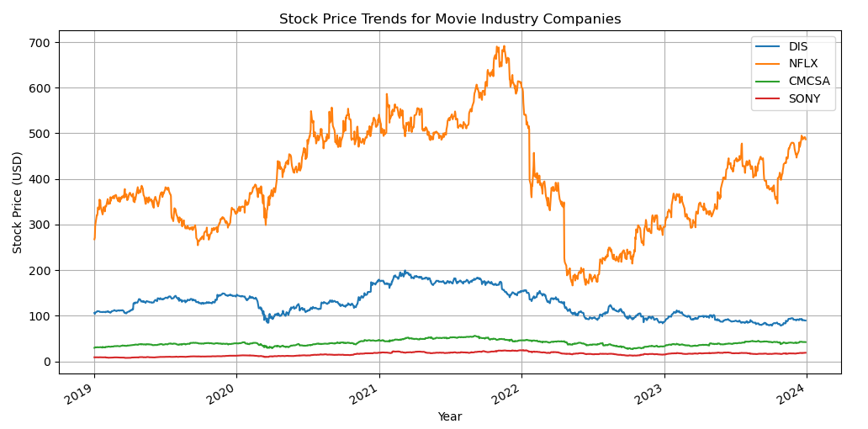
Stock Price Trends

Slide 10
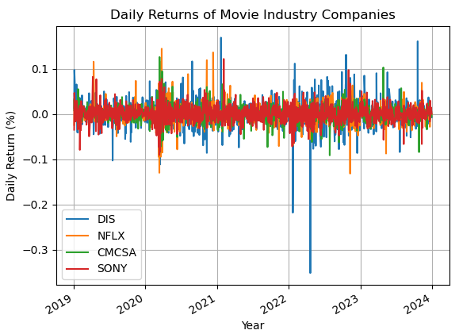
Daily Returns of Movie

Slide 11
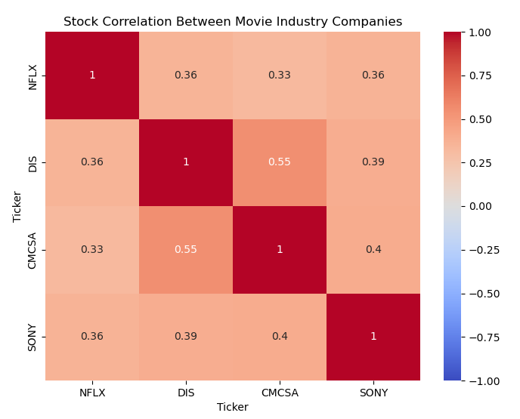
Stock Correlation

Slide 12
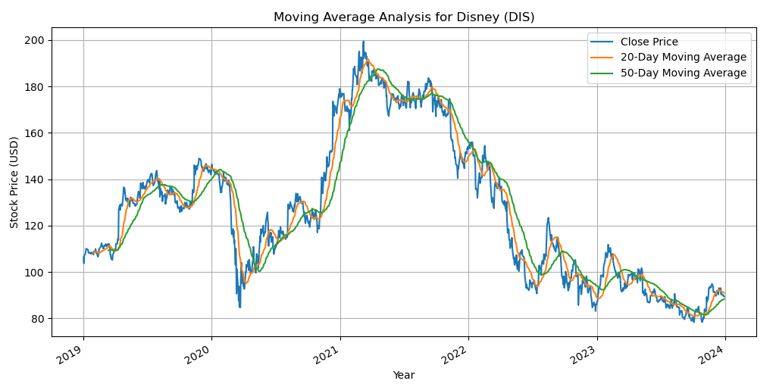
Moving Average

Slide 13
References
Moving Average
www.google.com
https://youtu.be/olzjNMKmeck
Yahoo Finance(Yfinance)-https://finance.yahoo.com
https://seaborn.pydata.org/tutorial/introduction.html

Slide 14
Thank You

